Slide 1
PRODUCT RE-ENGINEERING AND INNOVATION

Slide 2
WATERING OF PLANTS WITH AUTO – DETECTION METHOD

Slide 3
Overview
Whenever We go for vacations, We used to get worried about our plants because they need water on regular basis. After gone through several options to solve this problem as plants need water according to the moisture level of soil. So We have made Automatic Plant Watering System.

Slide 4
INTRODUCTION
In this system, soil moisture sensor senses the moisture level of the soil. If soil will get dry then sensor senses low moisture level and automatically switches on the water pump to supply water to the plant. As plant get sufficient water and soil get wet then sensor senses enough moisture in soil. After which the water pump will automatically get stopped Using Arduino UNO.
We have used a water pump in this system using DC motor. To operate this, it will require a relay module which is connected with microcontroller. Further we attached sensor to it to detect soil moisture.

Slide 5
MATERIAL REQUIRED
POWER SUPPLY
RELAY MODULE
MICRO CONTROLLER (ARDUINO NANO)
SOIL MOSITURE SENSOR
SOIL MOISTURE PROBES
PLANTS
WATER PUMP
WATER CONTAINER

Slide 6
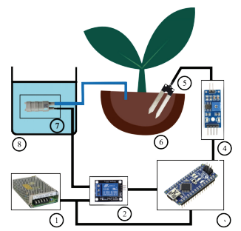
BASIC CONSTRUCTION & DESIGN
POWER SUPPLY (12 V DC)
RELAY MODULE (12 V , 4 CHANNEL)
MICRO-CONTROLLER(ARDUINO NANO) (OV - 5V)
SOIL MOISTURE SENSOR (OV – 3.3-5 V )
SOIL MOISTURE PROBES
PLANTS
WATER PUMP (18 WATT)
WATER CONTAINER (15 LTRS)

Slide 7
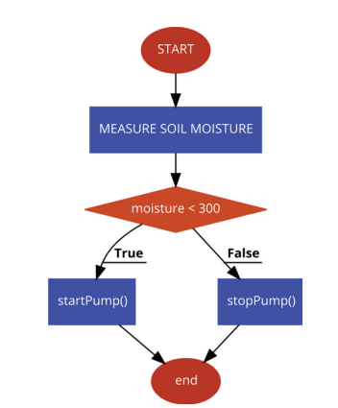
L
SENSOR
T
MICRO-CONTROLLER
U
O
Y
RELAY MODULE
A
WATER PUMP
WATER SUPPLY
WATERING
OF
PLANTS

Slide 8
WORKING PRINCIPLE
The main working principle behind this system is in connecting the soil moisture sensor, which was previously embedded into the plant, to the Arduino microcontroller, which is also connected to other electronic components. Measurement of soil moisture is done by the sensor which forwards the information and parameters regarding the soil moisture to the microcontroller, which controls the pump. If the level of soil moisture drops below a certain value, the microcontroller sends the signal to the relay module which then runs a pump and certain amount of water is delivered to the plant. Once the enough water is delivered, the pump stops doing its work.
Power supply has a task to power the complete system and the recommended voltage should respect the input supply range for the microcontroller, that is, from 7V to 12V. Relay module is a simple circuit consisting of a single transistor, several resistors, diodes and a relay and it is controlled digitally by microcontroller. Since the complete system should be embedded in a small box, Arduino Nano is a perfect microcontroller for this purpose because of its dimensions and its work performance. Soil moisture module is consisting of the two parts: amplifier circuit and probes. This module has digital and analog outputs, where digital output is set to logical 1 when the threshold is activated. The threshold is set by potentiometer. Analog output gives the real time information regarding the moisture in the plant and this output is used in the system. Water pump is connected to the relay module and it only works when the relay module gets a command from the microcontroller.

Slide 9
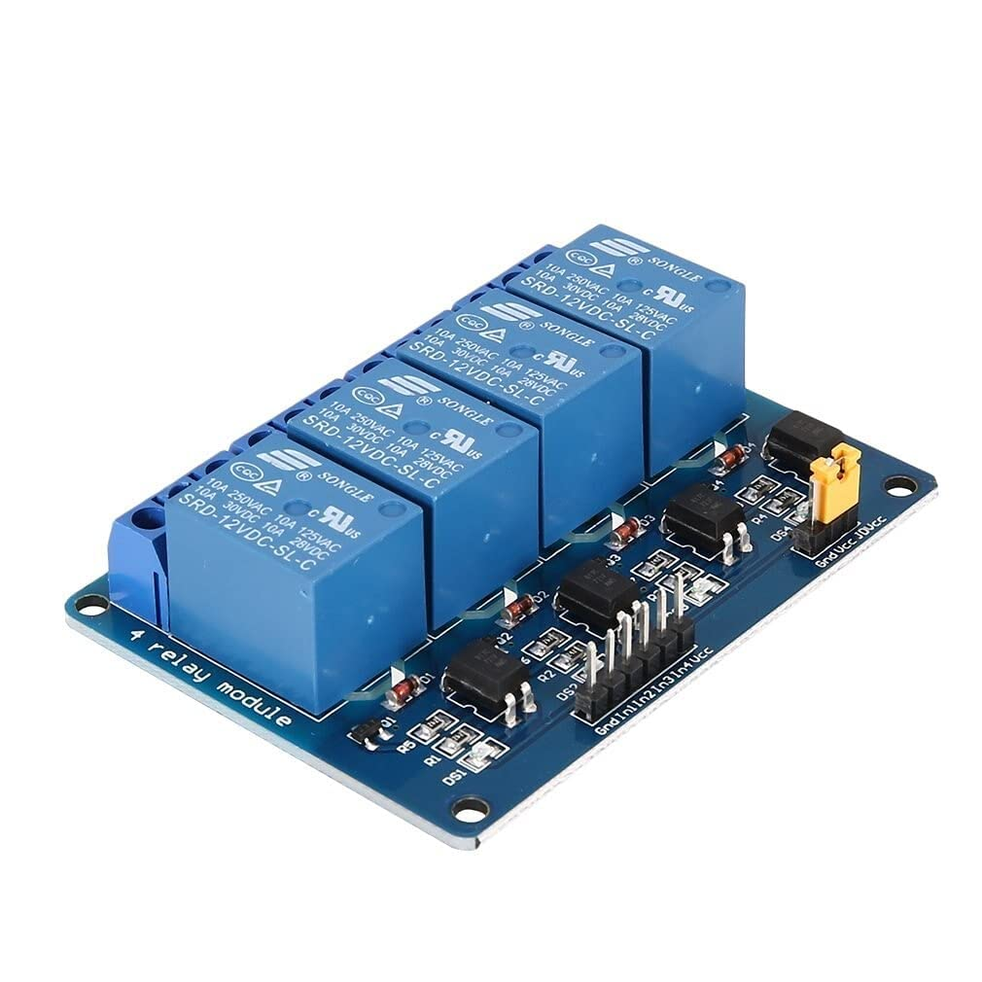
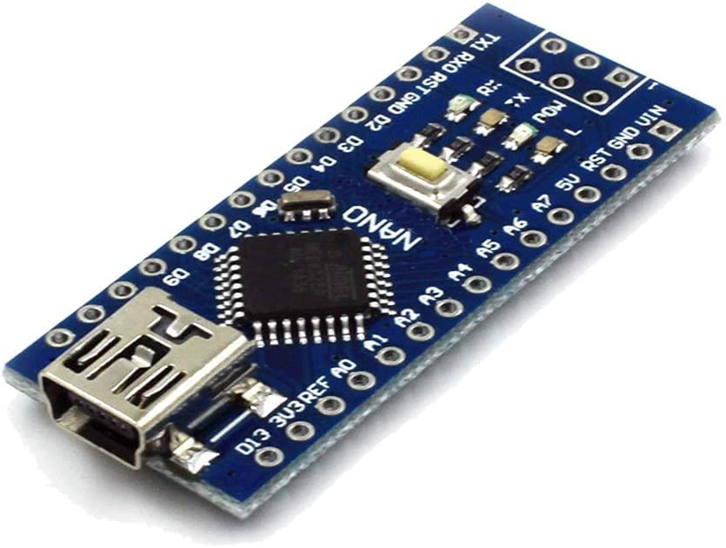
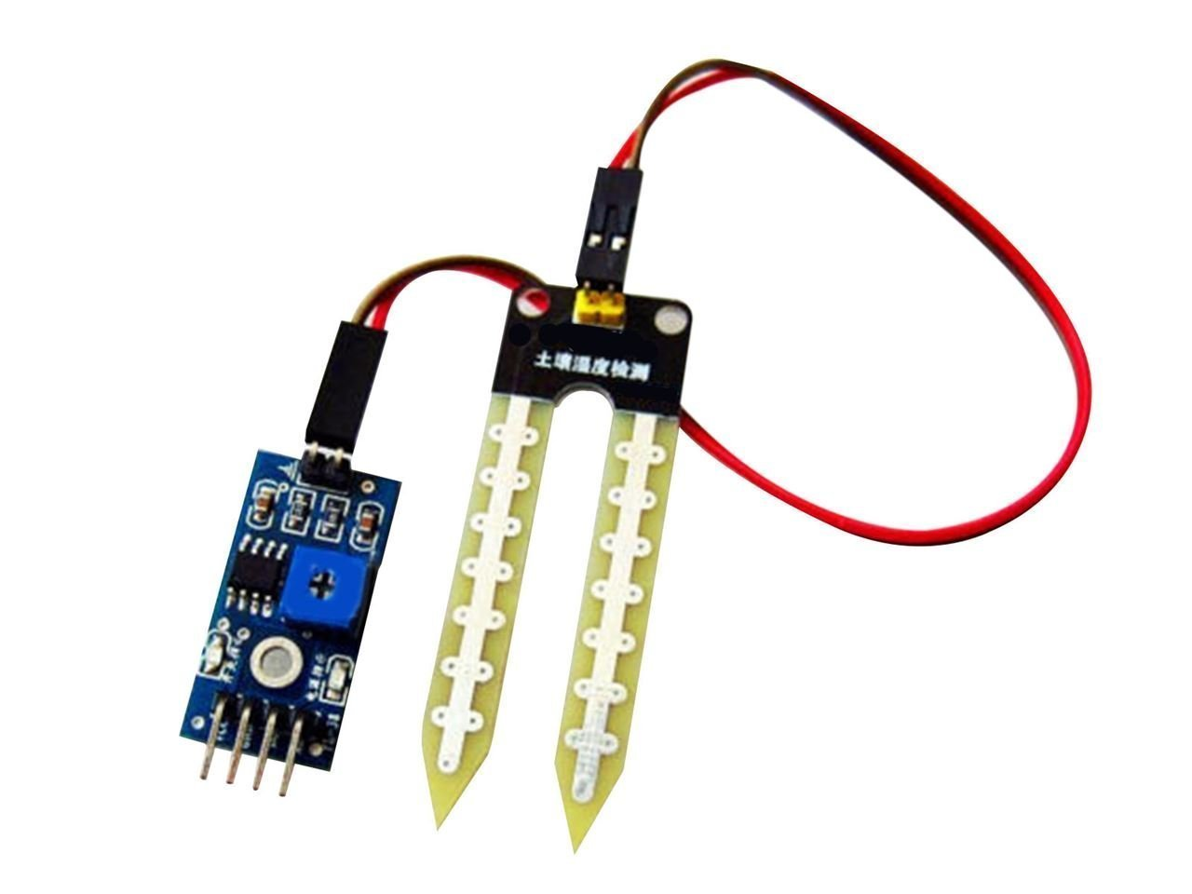
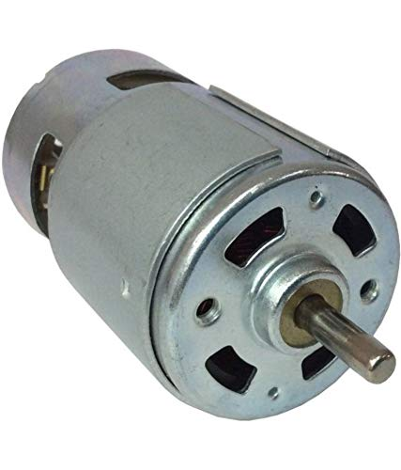
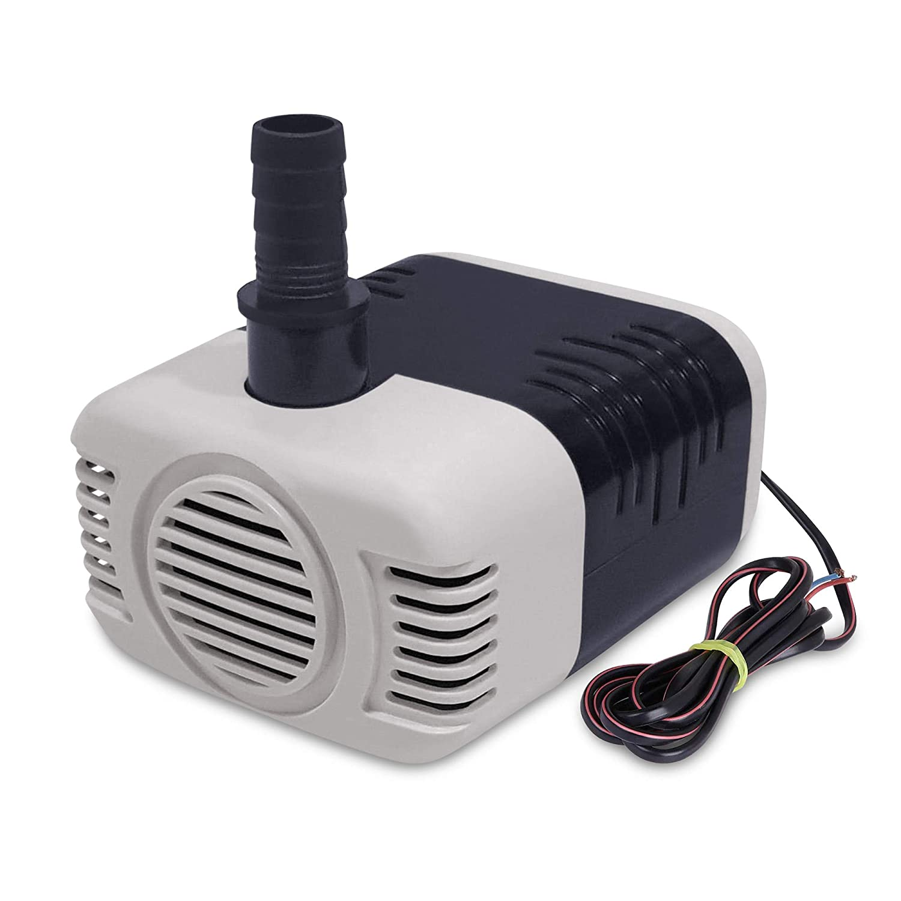
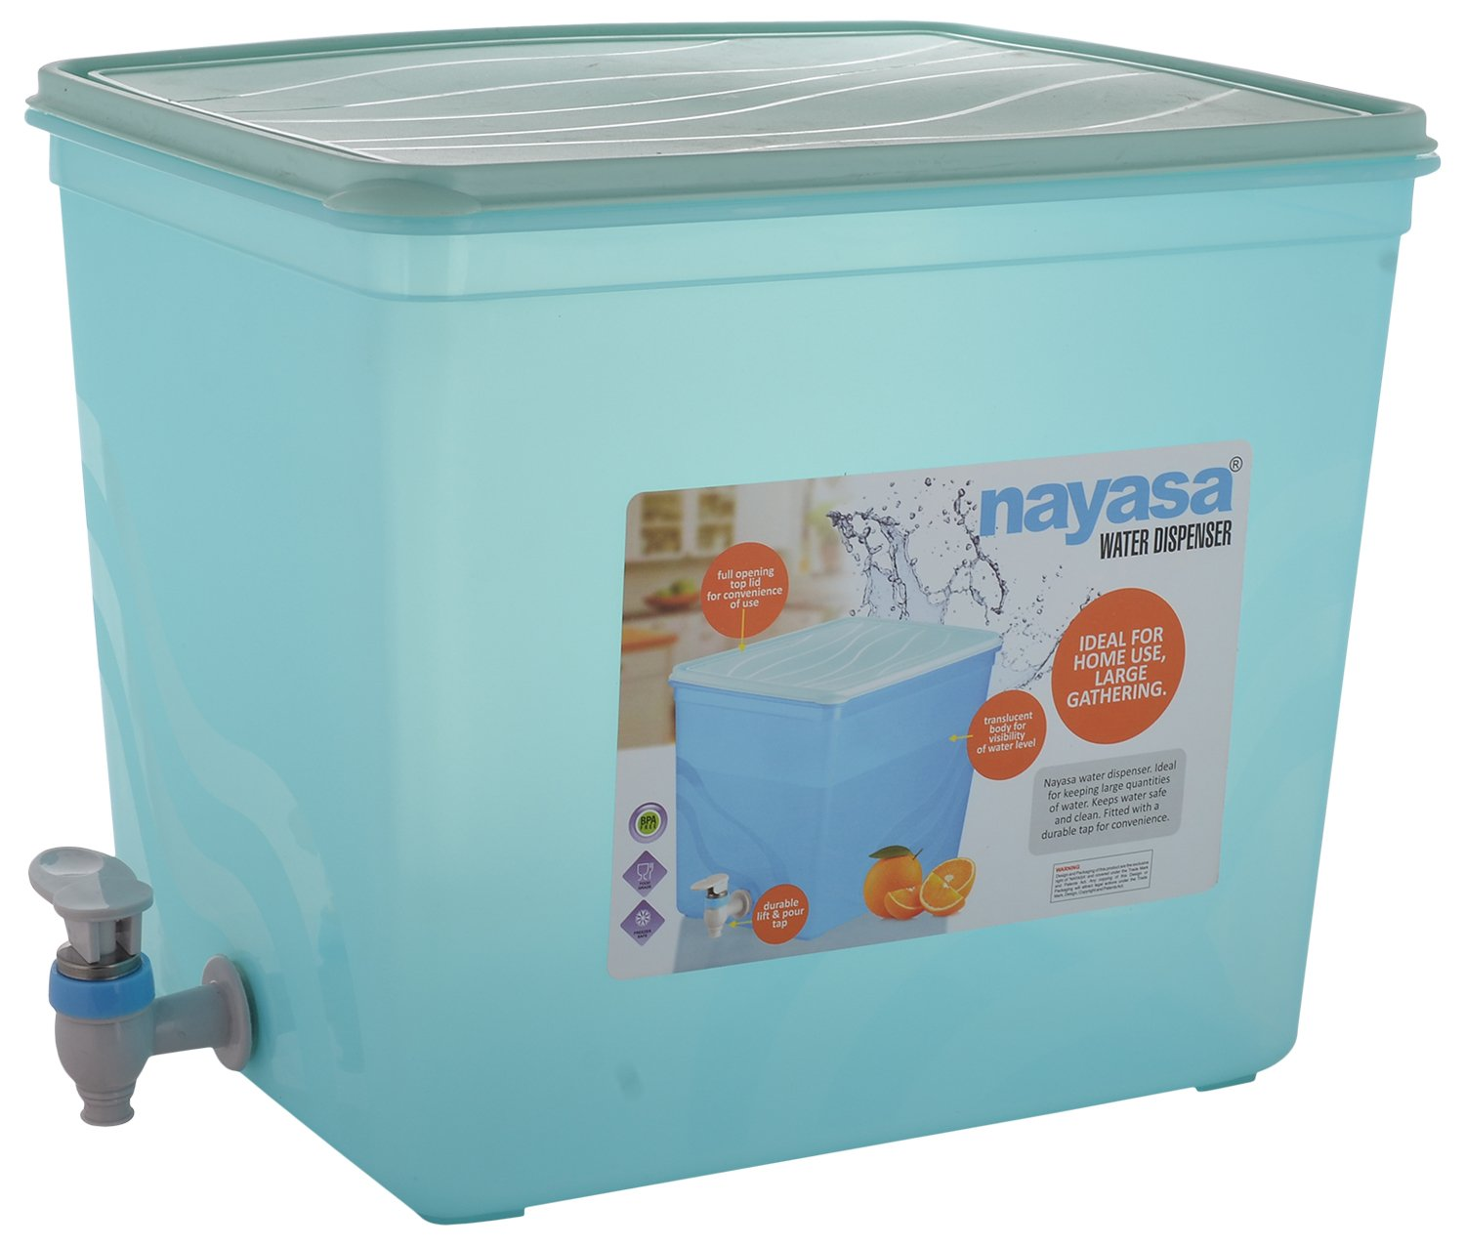
PRACTICAL FEASIBILITY
THE COMPONENTS WE USED IN THIS MODEL CAN EASILY BE REDEEMED IN BOTH ONLINE AND OFFLINE MARKET.
FOLLOWING ARE THE AMAZON LINK FOR EACH COMPONENT-
RELAY MODULE- https://amzn.eu/d/5fI7aCp
MICRO CONTROLLER (ARDUINO NANO)- https://amzn.eu/d/6UFidjR
SOIL MOISTURE SENSOR AND PROBES- https://amzn.eu/d/hIjTZwj
DC MOTOR (12 V)- https://amzn.eu/d/7qvHQwY
WATER PUMP- https://amzn.eu/d/5rBtDJS
WATER CONTAINER-https://amzn.eu/d/2xPf3O1

Slide 10
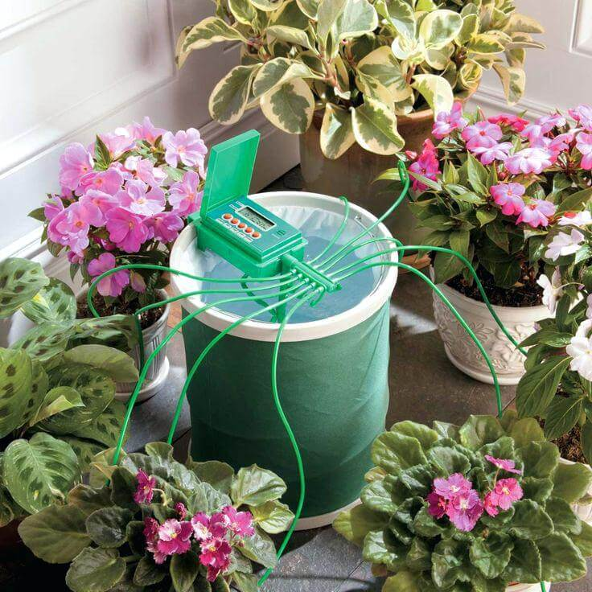
COSTING
SO , COST OF EACH COMPONENT IS –
RELAY MODULE- ₹275
MICRO CONTROLLER (ARDUINO NANO)- ₹749
SOIL MOISTURE SENSOR AND PROBES- ₹169
DC MOTOR (12 V)- ₹209
WATER PUMP- ₹275
WATER CONTAINER (10 LITRES)- ₹399
SUM TOTAL = ₹2076
THIS IS THE COST FOR ONE PLANT OR FLOWER BED.
IF WE WANT FOR MORE THAN ONE , WE CAN ATTACH UPTO 7 UNITS OF SOIL MOISTURE SENSOR AND PROBES WITH ONE INITIAL CIRCUIT .
SO, THE COST FOR MULTIPLE PLANTS OR FLOWER BED (UPTO 7) IS ₹3090

Slide 11
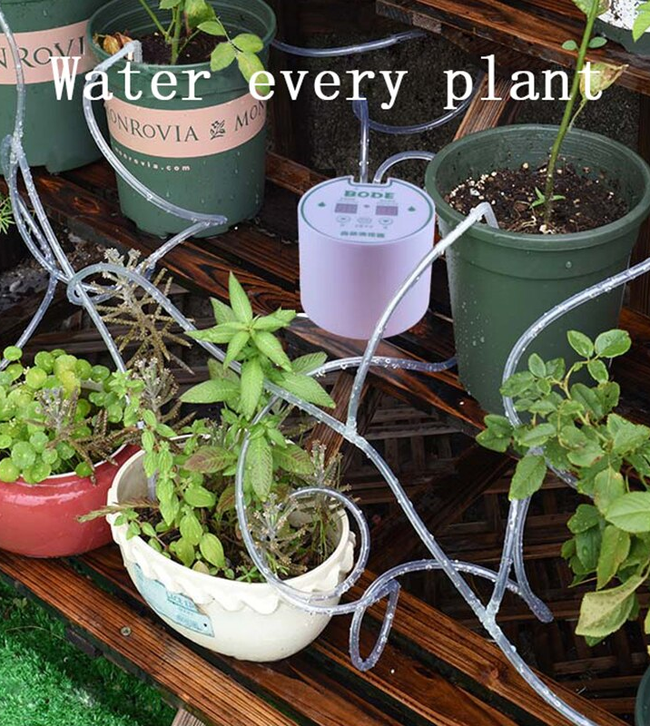
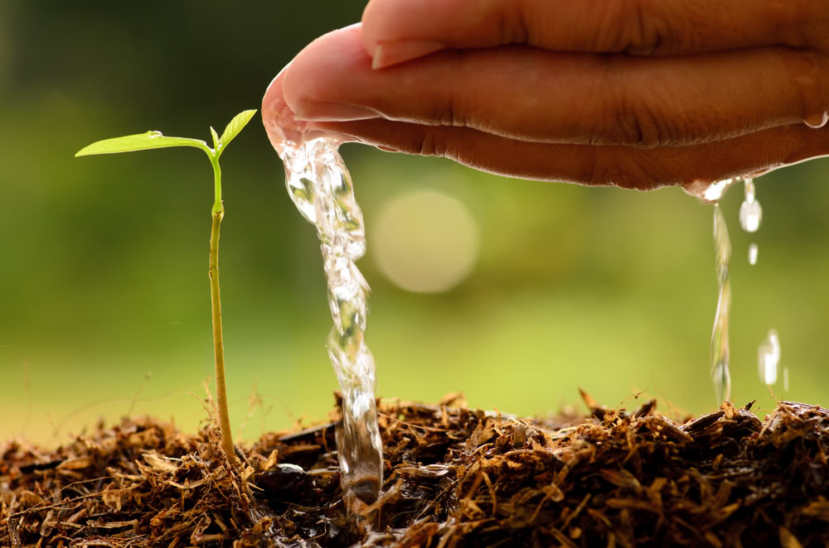
APPLICATIONS
AUTOMATION OF WATERING OF PLANTS CAN BE USED IN OR AT VARIOUS WAYS OR PLACE.
PLACES WHERE THERE IS SHORTAGE OF WATER.
APPLICABLE ANY TOPOGRAPHY.
REDUCING HUMAN TIME AND EFFORT ESPECIALLY IN SUMMERS.

Slide 12
ADVANTAGES DISADVANTAGES
Simple method of measurement.
It delivers the results immediately.
Watermark sensors and tensiometers are very low in cost.
Offers accurate results.
Watermark sensors offer larger moisture reading range from 0 to 200 cb or kpa.
It requires initial evaluation of site specific conditions before selection of appropriate moisture sensor.
It requires probe to be inserted in the soil. It requires labor to collect the data and maintain the measurement processes.
The measured values depend on properties of various materials. The correct interpretation and use of moisture data is needed.
Watermark sensors provide less accuracy in sandy soils due to large particles.
Watermark sensors are required to be calibrated for each soil types. Tensiometers also require periodic service.

Slide 13
ENCHANCEMENT
WE CAN IMPROVE THE MODEL BY FEW BUT EFFECTIVE WAYS-
ADD WATER TEMPERATURE CONTROLLER TO SUPPLY THE NORMAL TEMPERATURE WATER TO PLANTS.
ATTACH SOLAR PANEL TO MODEL FOR POWER SUPPLY AND CAN REDUCE ELECTRICITY CONSUMPTION.
ATTACH MORE SOIL MOISTURE SENSOR AND PROBES FOR ADDITIONAL PLANTS.
ALL THESE WAYS CAN IMPROVE AND MAKE THE MODEL EFFECTICE BUT THE COST OF MODEL WILL INCREASE RESPECTIVELY.

Slide 14
CONCLUSION
TILL NOW WE HAVE BEEN THROUGH A MODEL OF WATERING OF PLANTS WITH AUTO-DETECTION. WE HAVE SEEN IT’S REQUIREMENT , DESIGN & CIRCUIT DIAGRAM , WORKING PRINCIPLE , PRACTICAL FEASIBILITY , COSTING , APPLICATIONS , PROS & CONS AND ENCHANCEMENT.
SO, WE WOULD LIKE TO CONCLUDE BY SAYING THAT INSTALLING THIS SYSTEM AT HOME , OFFICES OR PLACE WHERE PLANTS CAN GET WATER DAILY WILL MAKE PLANTS ALIVE AND WASTAGE OF EXCESS WATER WILL BE REDUCE.
HOPE YOU LIKE THE PRESENTATION…

Slide 15
THANK YOU

